Slide 1
Healthcare
September 2020

Slide 2
Document Processing Challenges For Medical Professionals
Despite adoption of electronic health records, Healthcare is still a document-intensive industry as medical professionals are under pressure to:
Handle, manage, and protect patient forms, records, etc.
Reduce costs and increase efficiency.
Improve access to information.
Keep up with fast-paced working environment.

Slide 3
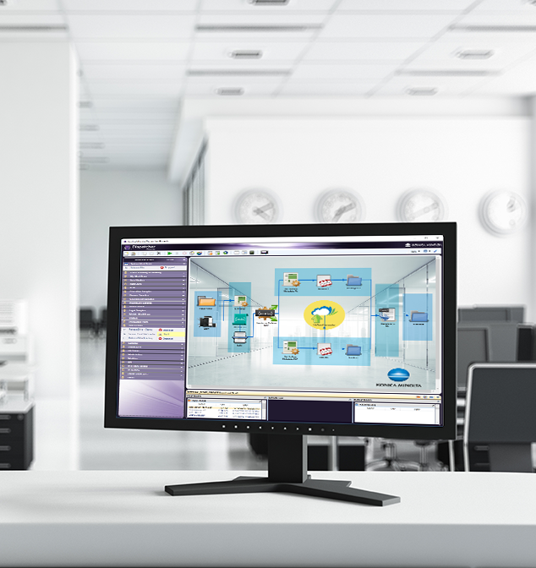
Dispatcher Phoenix is…
Award Winning!
Konica Minolta-developed, award-winning automation solution designed to:
Optimize business processes
Reduce costs
Increase productivity
Drive collaboration
Promote growth and innovation
Received the 2021 ‘ASTORS’ Homeland Security Platinum Award for Best Imaging Technology
Selected as BLI’s 2022 Pick for Outstanding Workflow Automation Platform

Slide 4
Drive Change with Dispatcher Phoenix’s Healthcare Solution
With Konica Minolta’s Dispatcher Phoenix, hospitals, clinics, and other healthcare organizations can:
Simplify their patient records and forms workflow & increase efficiencies.
Minimize the need for human intervention in redundant business processes.
Maximize productivity & reduce administrative costs.
Provide greater process visibility to identify potential bottlenecks.
Capture files automatically
Process and route jobs with ease
Distribute in a single step
Dispatcher Phoenix makes creating workflows easy!

Slide 5
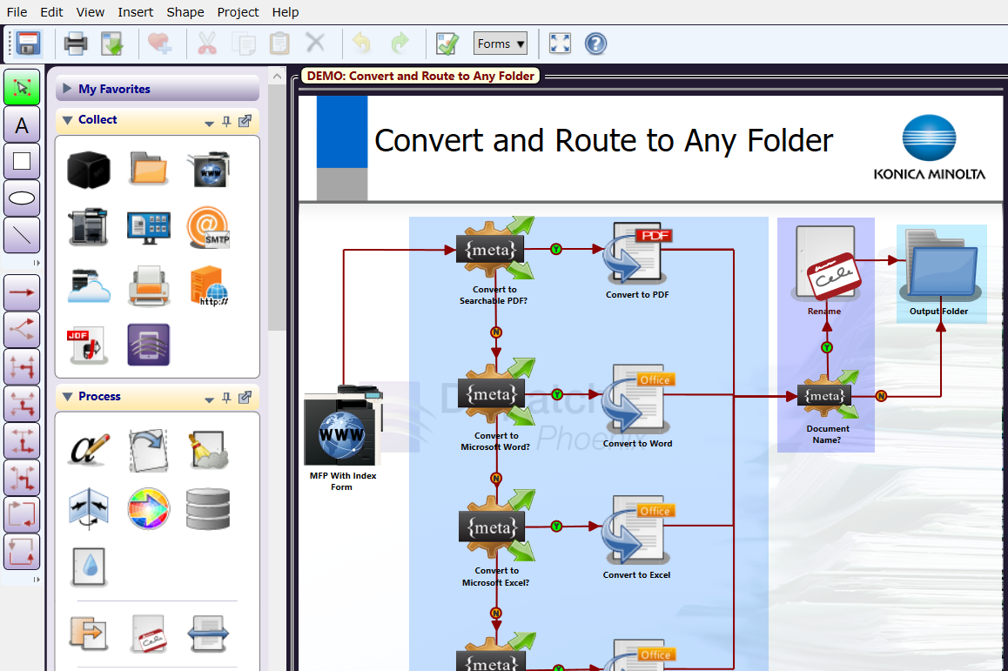
Easily Create and Manage Workflows
Award Winning!
Selected as BLI’s 2020 Pick for Outstanding Workflow Automation Platform
Dispatcher Phoenix’s intuitive Workflow Builder Tool is unique in the market.
Allows for advanced, customized workflows to be easily created to suit the specific needs of the hospital.
Easy-to-use features include:
Graphical icons
Drag-and-drop functionality
Drawing tools
Easy to follow validation messages

Slide 6
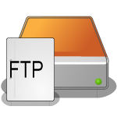
Optimize Workflows with LiveFlo
Displays files being processed through running workflows.
Makes it easy to identify bottlenecks.
Ensure that inputs, processes and outputs are optimized.

Slide 7
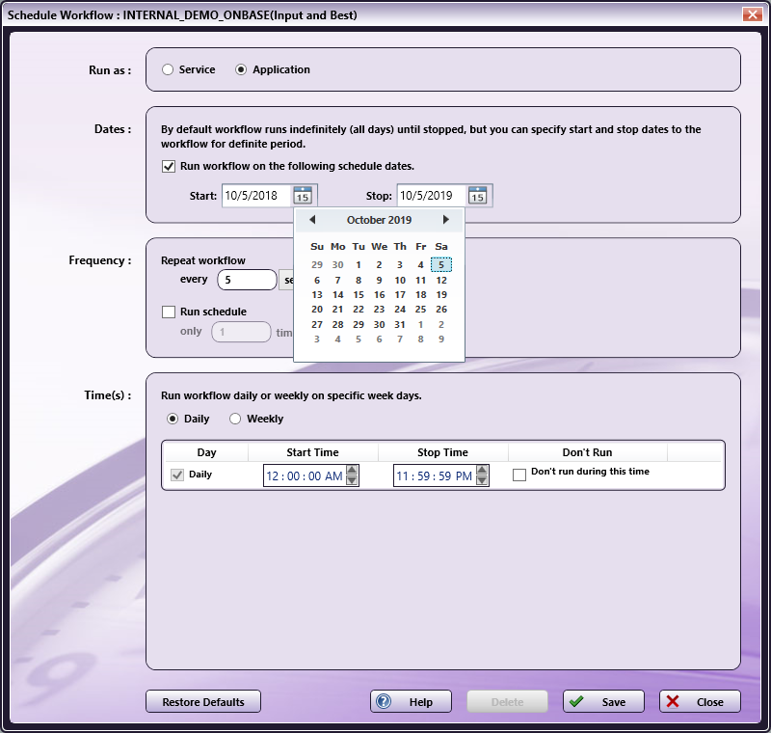
Schedule Workflows to run when you need them!
Award Winning!
Specify a day of the week or time of the day along with a frequency to ensure workflows complete your automation needs when it’s most convenient for the team.
Save valuable time and resources by scheduling high-volume, heavy processing workflows after working hours.
Schedule workflows to run as a service continually while the PC is on.

Slide 8
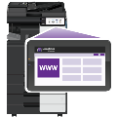
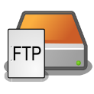
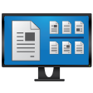
Advanced Capture
Automatically collect documents from a variety of ways for advanced processing, routing, printing, or storing, including:
MFP
Watched Folder
Email Inbox
Mobile Device
Workstation
Web Capture
FTP Server
Dropbox Folder
LPR Print Queue
Etc.

Slide 9
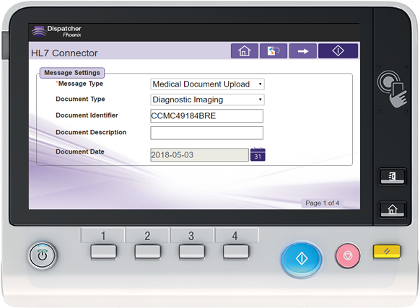
Automated Document Processes
Dispatcher Phoenix supports a variety of document processing tasks from the most simple to more complex including:
Annotation
Watermarking
Rename Files
PDF & Microsoft Office Conversion
Barcode Processing
Secure Prescription Printing
Intelligent Redaction
CDA Generator
Zonal Extraction
HL7 Scan Integration to EHRs
Many more…

Slide 10
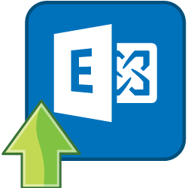
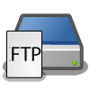
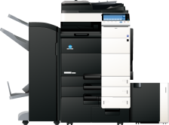
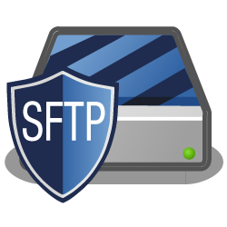
Store Documents In A Single Step
Customize your workflow to send processed documents to a variety of outputs in a single step! Distribution options include:
Folder on the network or Desktop
FTP Server
SFTP Server
Email
Printer
Windows Fax
Production Print Systems
Guardian by LawLogix
OnBase by Hyland
Workshare
Laserfiche
And More…

Slide 11
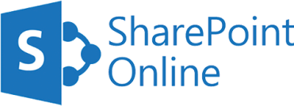
Sharing Documents to Drive Collaboration
Send processed documents to major cloud storage systems
Easy-to-use cloud connectors provide single sign-on to the cloud

Slide 12
Powerful Scalability
With Dispatcher Phoenix’s enhanced scalability, you can create unique, modular, cost-effective solutions tailored to changing business needs. Optional add-in modules include:
Forms Processing
Advanced OCR
2D Barcode Processing
Copy Defender
Release2Me for secure print release
Specialized connectors
Much more…

Slide 13
Healthcare-Specific Use Cases

Slide 14
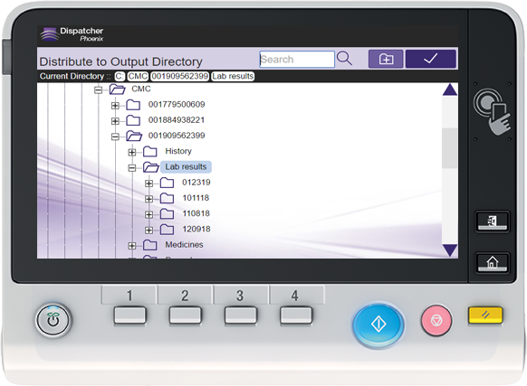
Improve Efficiencies with Intuitive Scanning & Indexing
Quickly & easily scan and index healthcare documents using a familiar, Windows-like folder structure.
Medical Assistants can browse their PC’s folder library and select the correct folder to store documents at the MFP Panel.
Search existing patient or medical folders and create new folders on the fly with ease.

Slide 15
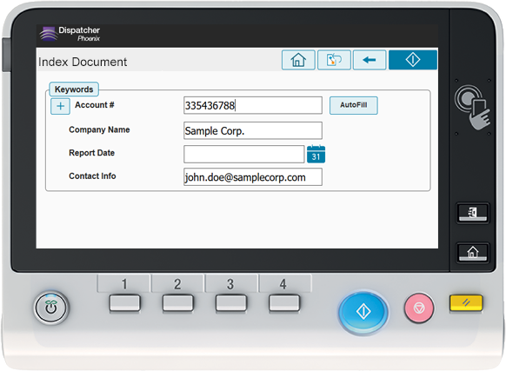
Send Processed Medical Documents Directly to OnBase
Today’s healthcare organizations need to make sure that medical information, such as doctor’s notes & reports, can be shared and accessed immediately.
For those hospitals that use OnBase by Hyland to manage clinical and back office documents, Dispatcher Phoenix offers a direct connector to OnBase.
Medical professionals can index, scan, and store patient records, charts, lab reports, & more directly in OnBase – right from the MFP.
Familiar, easy-to-use Interface closely resembles OnBase client experience.

Slide 16
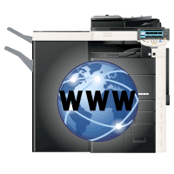
Improve Connectivity with EHR Integrated Scanning
Using HL7 (Health Level 7 International) and CDA Formats:
Dispatcher Phoenix facilitates the seamless exchange of healthcare information.
Allows medical professionals to look up patient information at MFP and scan securely into EHR applications.
Powerful addition to Healthcare workflow – files can be scanned, processed (converted, information redacted, etc.), before distributed to other healthcare systems.
Provides healthcare organizations with the connectivity that they need to meet Meaningful Use requirements.

Slide 17
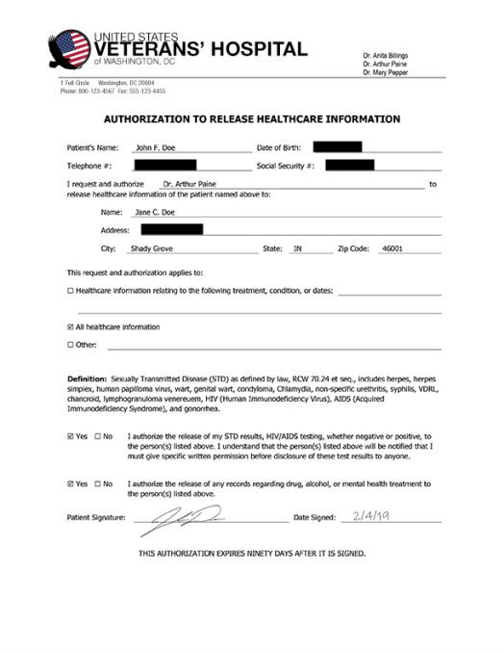
Save Time with Intelligent Redaction
Set up a simple search operation to quickly redact, highlight or strikeout sensitive information in medical forms, patient records, letters, etc., to comply with legal privacy requirements.
Intelligent redaction permanently removes information from medical documents, such as patient details.
Customize, create or remove redaction search terms at the MFP Panel.

Slide 18
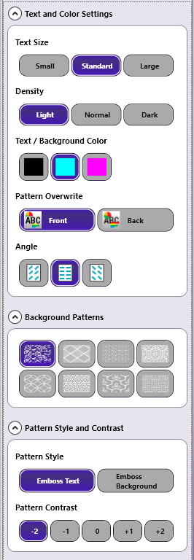
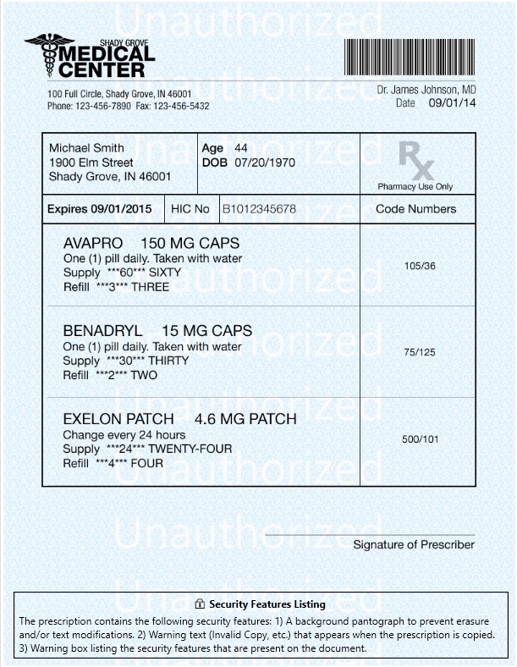
Rx Shield for Secure Prescription Printing
Help hospitals comply with tamper-resistant printed prescription mandate from the Centers for Medicare & Medicaid Services (CMS).
Rx Shield saves hospitals money by eliminating the need for costly pre-printed forms.
Automatically adds a patterned background with Security Warnings (e.g., the words “Unauthorized”) that appear when the prescription is copied. Patterned background helps prevent erasure or modification of text on the prescription.
Security Features box automatically added to the bottom of the prescription to alert pharmacists of fraud-prevention features.

Slide 19
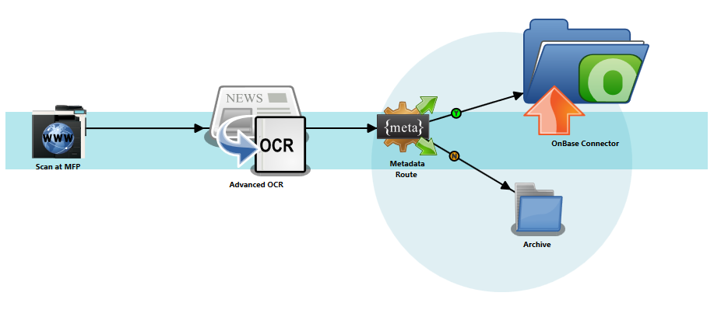
Automate Patient Data Extraction with Advanced OCR
Manually entering data from medical forms to other applications or systems is an error-prone and time consuming process.
Dispatcher Phoenix’s Advanced OCR processing allows for:
Automated data extraction to eliminate manual data entry.
Streamlined document distribution using content-based rules, known as OCR zones.

Slide 20
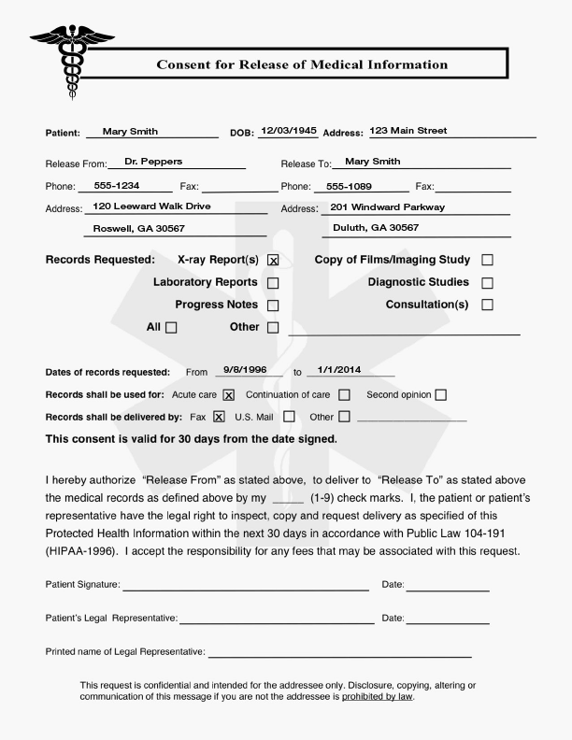
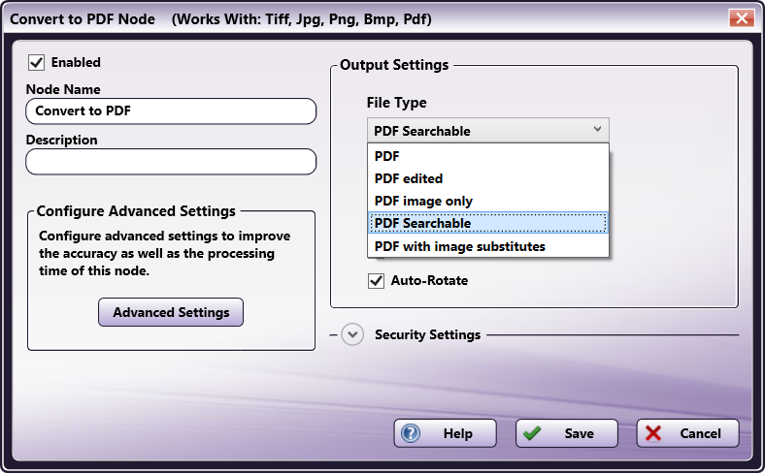
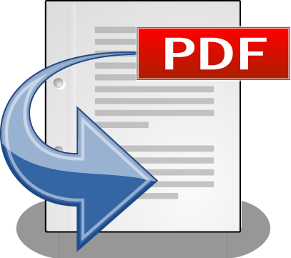
Find Records and Files Easily
Maintain the security and integrity of medical documents by automatically converting scanned image files to a variety of PDF formats.
Search, retrieve, view, and print healthcare documents as needed while keeping originals secure and intact.
Transform paper documents to Searchable PDF file format to easily find patient information later, or PDF/A formats for archiving.

Slide 21
How Medical Professionals Benefit From Dispatcher Phoenix
Automation drives a fast and efficient work environment.
Patient information can be securely transmitted to an EHR system, while following international industry standards.
Shrinking the processing time for individual steps (e.g., redacting) saves hospitals time and money.
Forms and records are never lost or misrouted.
Eliminates the need for costly, secure, pre-printed prescription forms by printing on plain paper.
Drives teamwork & communication.
Complies with HIPAA & Other Regulatory Standards.

Slide 22
Resources

Slide 23
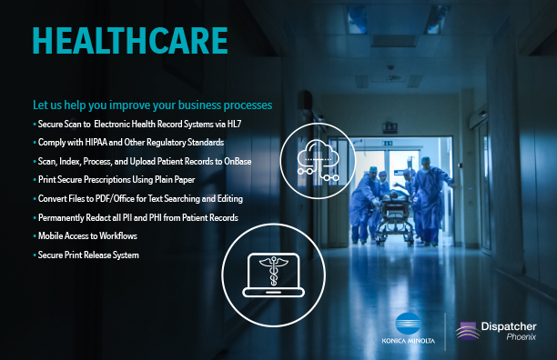
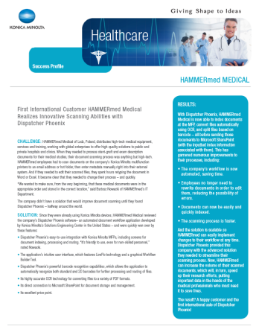
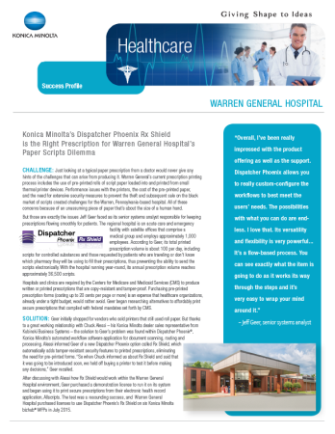
Marketing Collateral
Dispatcher Phoenix Brochures
Healthcare.
HL7 Connectivity.
Rx Shield.
Battlecards.
Sell Sheets for Connectors
OnBase.
Worldox, Workshare, Laserfiche etc.
Healthcare Case Studies
HAMMERmed.
Warren Hospital.

Slide 24
Additional Resources
Demo Licenses
Fully-functional 30-day demo licenses.
Sample Workflows
Fully-configured sample workflows include templates for Healthcare features.
NFR Licenses
Fully-functional licenses to help you demo or test workflows.
MFP Simulator
Show your customers how easy it is to use Dispatcher Phoenix with our Flash-based MFP Simulator…now available with bizhub, i-Series, and production print panel displays!

Slide 25
Thank You
sec@kmbs.konicaminolta.us

